Slide 1



HCN in the Taurus Molecular Cloud
Samantha Andrews
Undergraduate at the University of Arizona
Mentor: Dr. Yancy Shirley
Benefactor: Rincon Research
April 2019

Slide 2
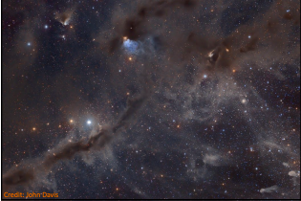
Background
Molecular Cloud
  Dusty H₂ regions where stars form
Hydrogen Cyanide (HCN)
  Traditionally used as a dense gas tracer
  Published studies in very active regions
  We tested this hypothesis in a more quiescent cloud - Taurus
Extinction (A_{v})
Estimate of dust extinction along line of sight at visual wavelengths
Proportional to column density of H₂

Slide 3
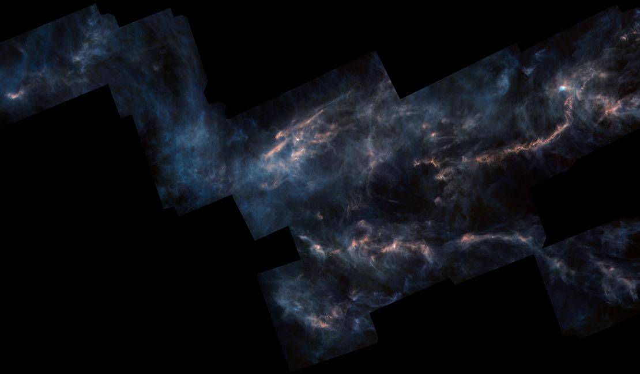
Motivation & Method
Goal: Test if Hydrogen Cyanide probes dense molecular gas
Method:
Radio observations of Taurus region to observe HCN
Analyze primary hyperfine line in spectra
Compare the visual extinction and integrated intensity
Herschel

Slide 4
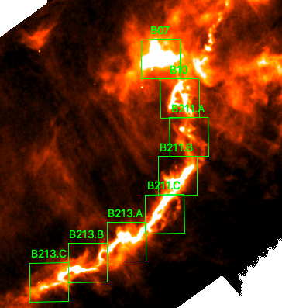
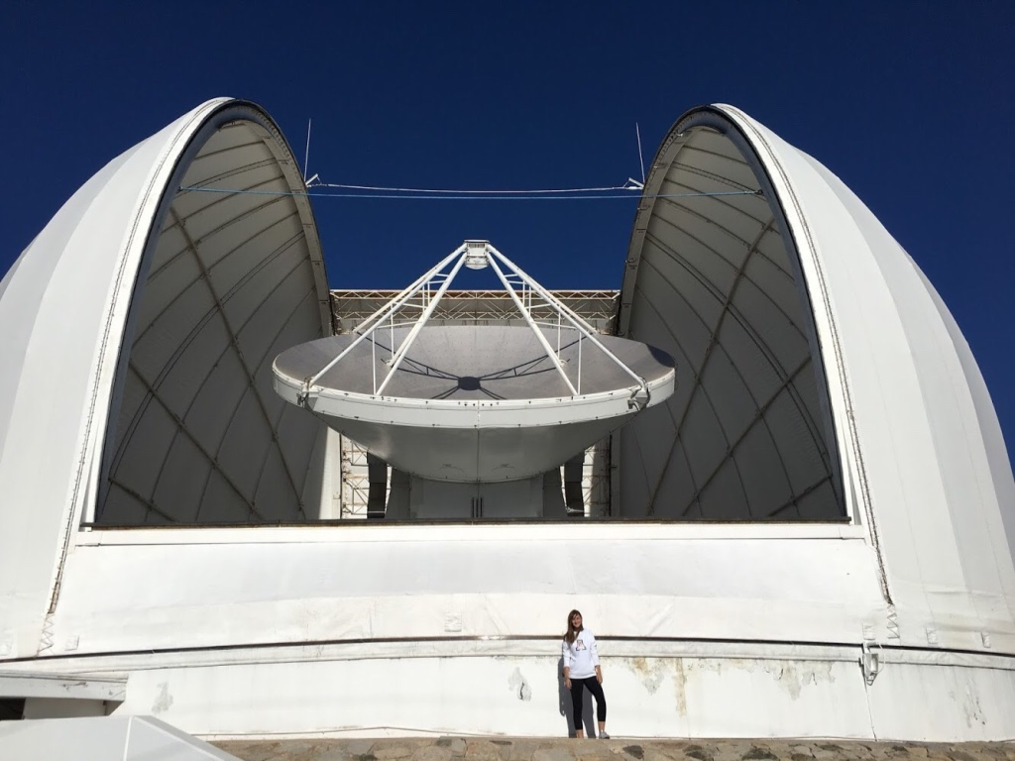
Observations
Arizona Radio Observatory 12 meter radio telescope at Kitt Peak National Observatory
On the fly mapping
Notes:
map of thermal dust emission
dust grains absorb light at short wavelengths and re-emits at far IR (heat up a little, Wien’s law, the black-body radiation curve for different temperature peaks at a wavelength is inversely proportional to the temperature)
HCN is a linear molecule and has rotational transition in the radio part of the spectrum
OTF most eficient way bc it writes out data continuously
Freq: 88.6318475 GHz LSB (centers up on F=2-1 hyperfine line)
AROWS 19.5 kHz mode with central 1024 channels

Slide 5
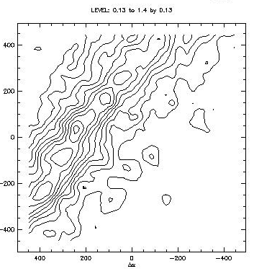
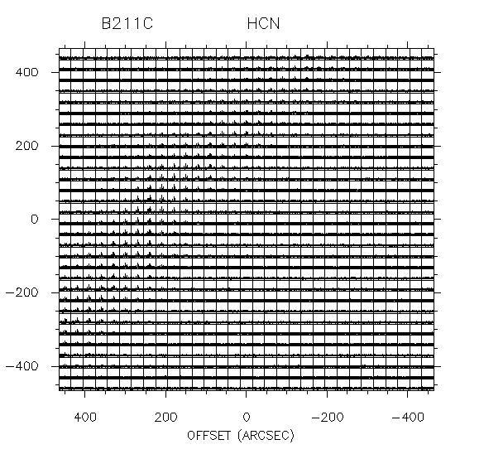
HCN Mapping
HCN integrated intensity contours 3 sigma
Notes:
zoom in on B211C to see spectra
brightest at center of contour map
take spectra and zoom in on it even more to see that there are actually three peaks. these three peaks are due to hyperfine lines

Slide 6
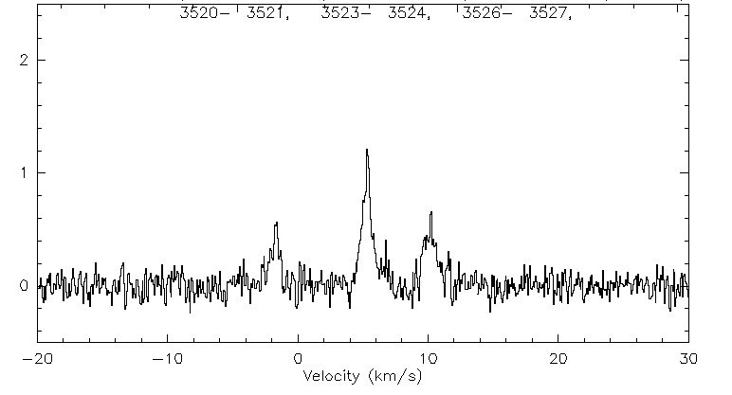
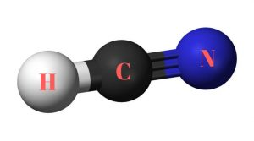
Hyperfine Lines
Energy levels split
Analyze middle 2-1 transition
Calculate integrated intensity
Notes:
Hyperfine lines come from the spin of the nitrogen nucleus interacting with the rotation of the molecule
energy levels split
three transitions-middle is the strongest, best signal to noise
zoom in on center peak the get the area under the spectral line by integrating
rotational transition means it has a very specific rotation, a fixed angular momentum

Slide 7
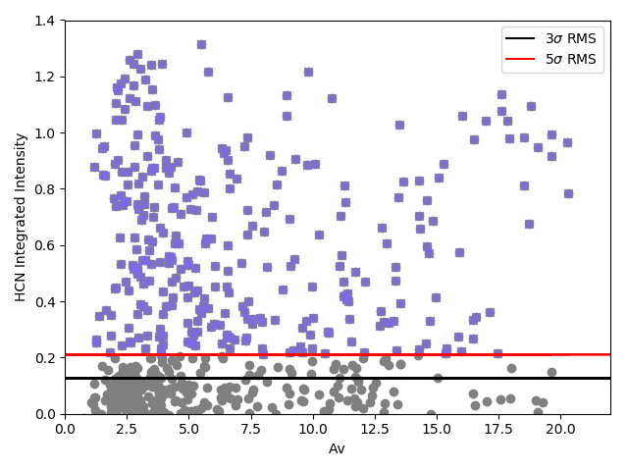
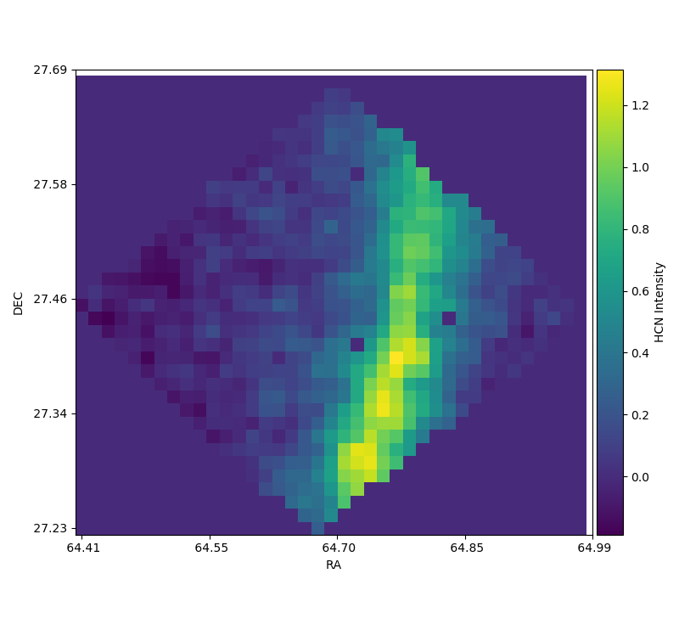
Comparison of HCN with Av
Detecting more HCN at low A_{v} than at high A_{v}
Notes:
with the integrated intensity we can compare how much dust there is, how much material is along the line of sight
this shows we are detecting HCN down to a couple of Av
there is more at low Av than at high Av so we made a fraction

Slide 8
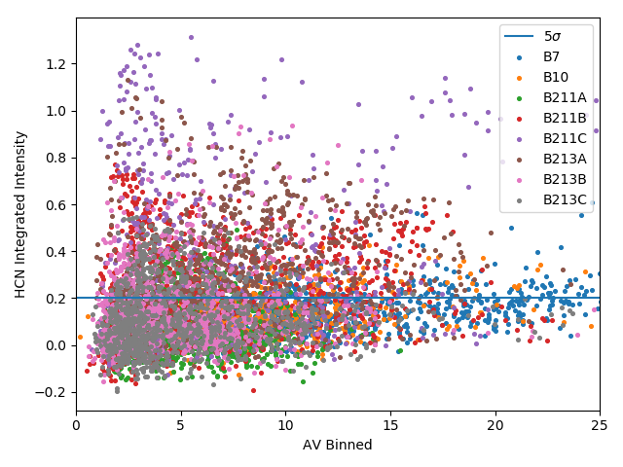
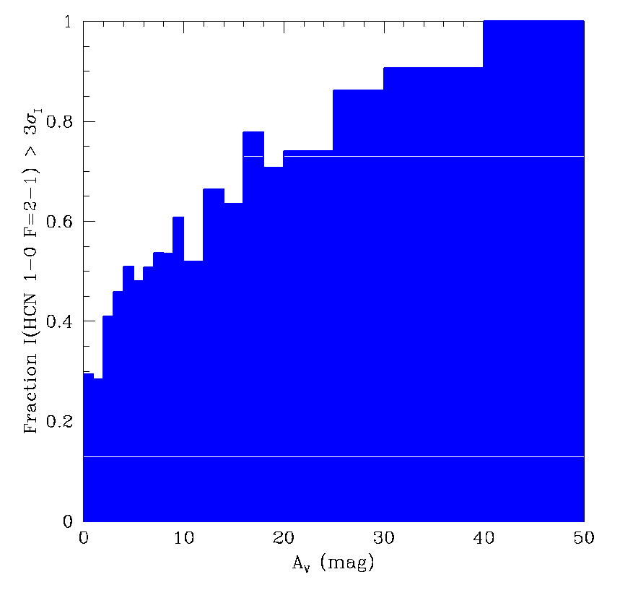
Where HCN is detected
A_{v}
Detection fraction continuous with A_{v}
As density increases, HCN fraction increases
Notes:
the histogram shows how many points above the line and below the line of 5 sig
it is a continuous function so there’s no real cut off or jump where it’s super obvious that HCN is detected way more at some high density
detected 100% of the time as high Av, but at low Av, only detected like 30% of the time

Slide 9
Conclusions
HCN known is previously known to be a good dense gas tracer in very active regions of star formation dominated by protostars.
We found that it is not an exclusively dense gas tracer in younger/quiescent regions dominated by prestellar cores.
HCN is present in gas of all different densities with no sharp cut off
Most HCN detections are at low A_{v} (less than 5 mag)

Slide 10
Future Plans
More observations on the 12m to extend the region
Compare results to other molecular clouds that are more active
Thanks to:
  Yancy Shirley
  Samantha Scibelli
  University of Arizona
  UA/NASA Space Grant
  Mike Parker & Rincon Research

